Slide 1
Simplifying Machine Learning with Pipelines
DIRISA Datathon | Instructor: Kgaugelo Mmakola

Slide 2
What is a Pipeline?
A Pipeline is a way to streamline the ML process.
It connects multiple steps (like preprocessing and modeling) into one single object.
Helps to avoid repeating code and ensures data consistency.

Slide 3
Why Use Pipelines?
Ensures preprocessing is applied consistently (e.g., scaling, encoding).
Helps during cross-validation and model tuning.
Makes saving and deploying models easier.

Slide 4
Components of a Pipeline
Typical pipeline steps:
Imputer: Fill missing values
Scaler: Standardize or normalize
Vectorizer (for text): Convert text to numbers
Model: Train model on processed data

Slide 5
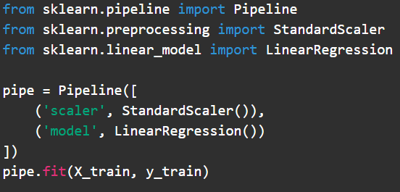
Pipeline Code Example (Regression)

Slide 6
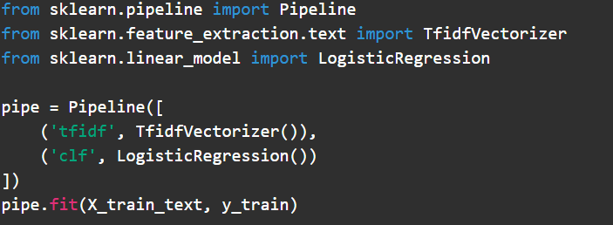
Pipeline Code Example (Text Classification)

Slide 7
Grid Search with Pipeline

Slide 8
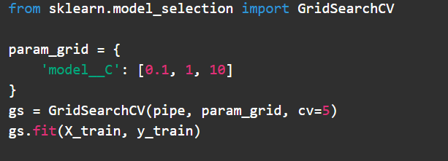
Grid Search with Pipeline

Slide 9
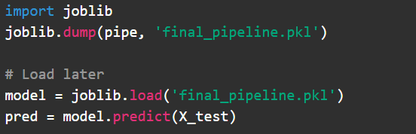
Saving and Loading a Pipeline

Slide 10
Summary
Pipelines help organize ML code
Improve reproducibility & deployment
Work with both regression and classification tasks
Recommended for all serious ML projects

Slide 11
Thank you!!

